Slide 1



internship program at Ejada Systems - Emerging
Technologies Track (IoT Robotics)
Reinforcement Learning for Robotic Control:
A Journey into Non-Classic Control Systems
next slide
Sarah Shaban Ali

Slide 2


02
Learning Phase First 3 Weeks
Week 1: Introduction to Reinforcement Learning
Understood core RL concepts: agents, environments, rewards, and policies.
Explored key algorithms: Q-learning, Policy Gradient, Actor-Critic.
Reviewed real-world RL applications in robotics.
Week 2: Frameworks & Tools
Installed and configured Gymnasium and Stable-Baselines3.
Learned to register and customize Gym environments.
Explored observation/action spaces and reward functions in robotic control.
Week 3: Applied Understanding
Set up FetchPush simulation environment.
Ran baseline models using default rewards and PPO algorithm.
Visualized training logs using TensorBoard.
Evaluated initial policy behavior via GUI and episode monitoring.
next slide

Slide 3
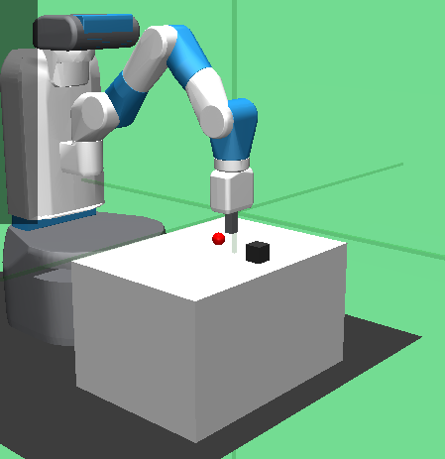
03
Internship Objectives
Train a robotic arm (Fetch) using RL
Design & compare reward functions
Experiment with multiple algorithms
Evaluate performance and visualize results
next slide

Slide 4
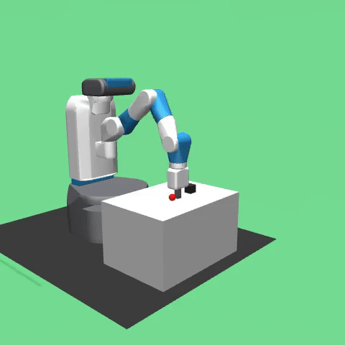
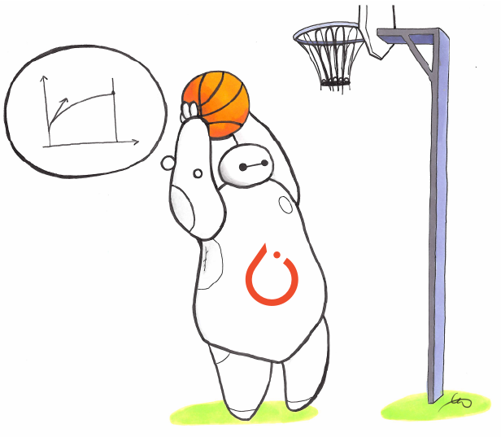
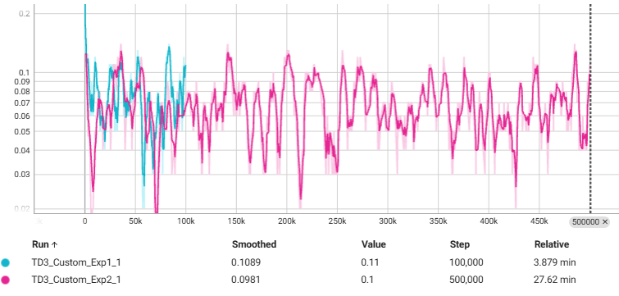
04
Tools & Technologies
Python, Gymnasium, Stable-Baselines3
TensorBoard for monitoring
MoviePy for video recording
Algorithms: PPO, TD3, SAC
next slide

Slide 5

05
Environment Setup
FetchPush environment
Observation/action space
GUI + inference scripting
Custom environment registration
next slide

Slide 6
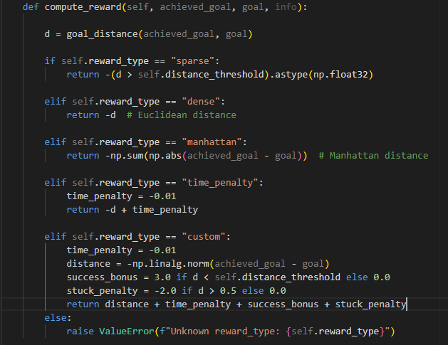
06
Reward Function Engineering
Types used: Dense, Manhattan, Time_Penalty, Custom
Logic of each function
Best-performing function: Custom
How rewards shaped behavior
next slide

Slide 7
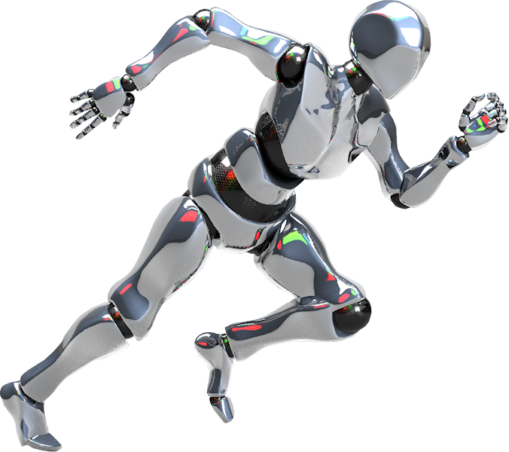
07
Algorithms & Training
PPO, TD3, SAC
Key hyperparameters used
Logging with TensorBoard
Challenges in stability & convergence

Slide 8
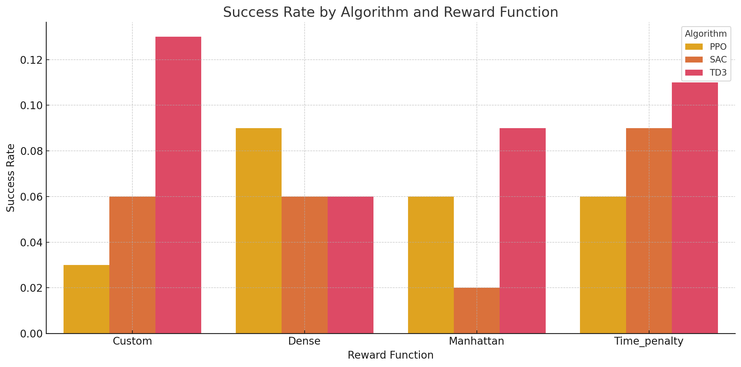
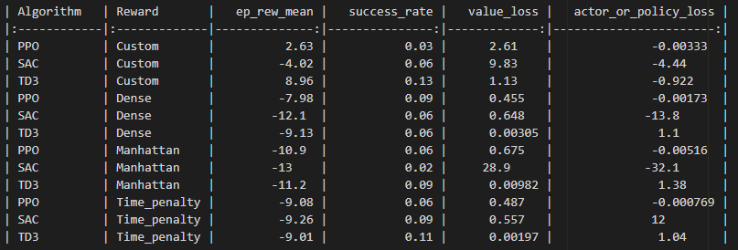
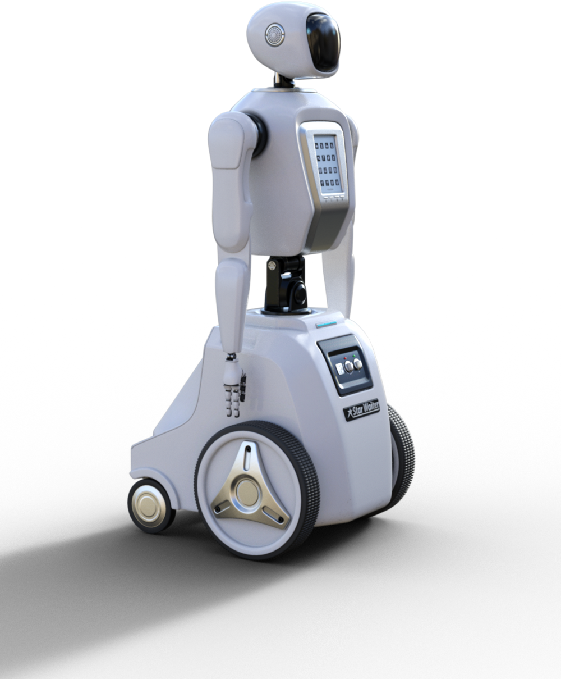
Experimental Results
08
Table/heatmap of performance metrics:
ep_rew_mean, success_rate, value_loss, policy_loss
Graphs: bar chart comparing reward functions per algorithm
next slide

Slide 9
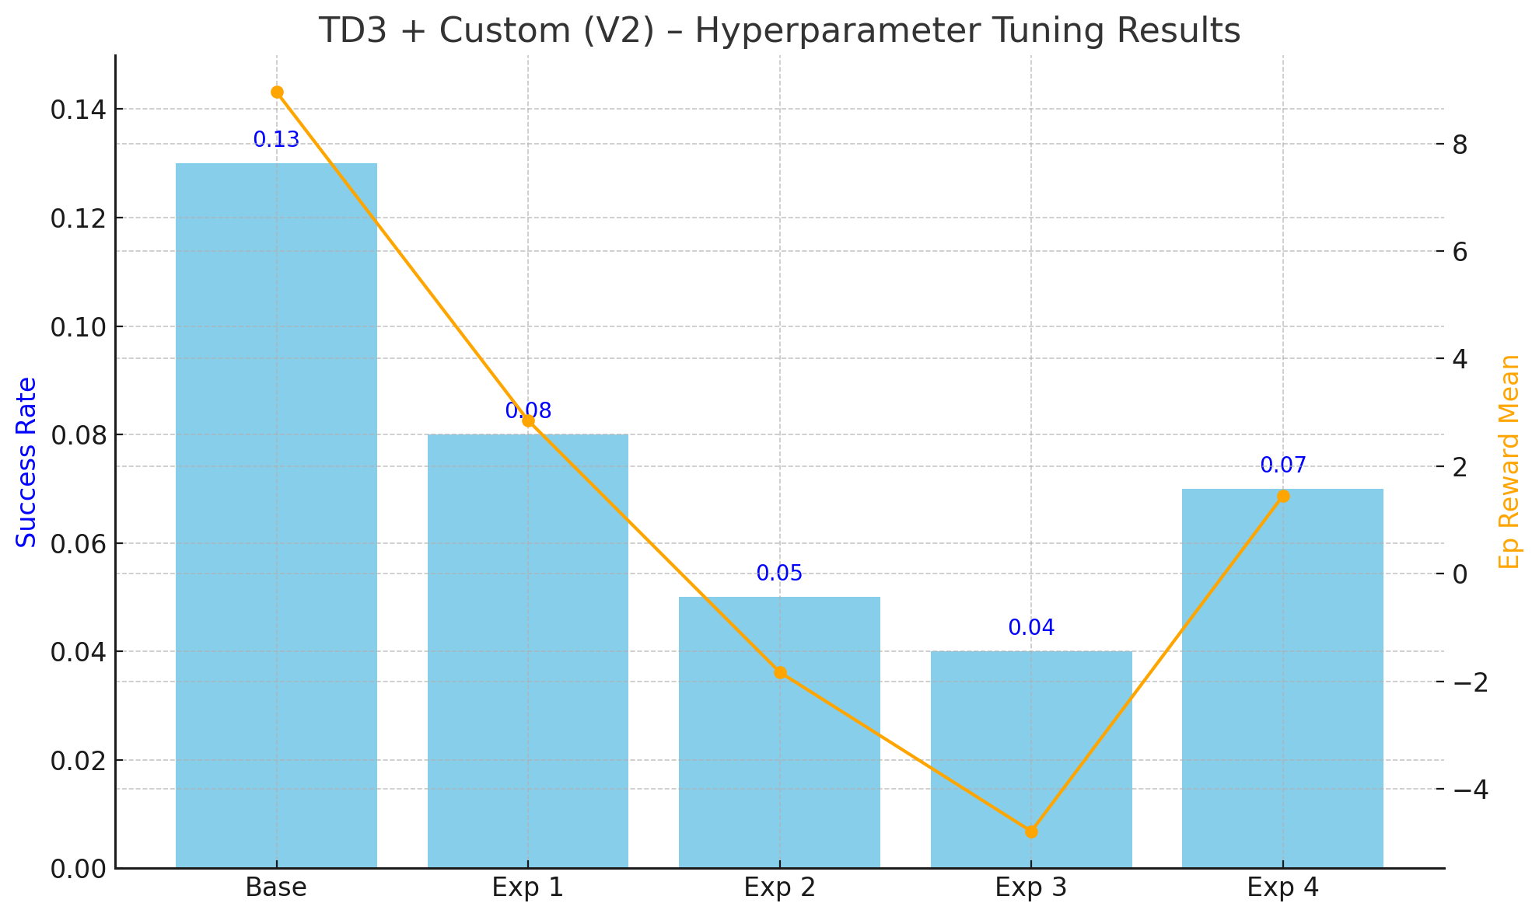
09
Hyperparameter Tuning
Experiments with learning rates, gamma, noise
Impact on reward & success rate
Key takeaway: TD3 + tuned Custom performed best
next slide

Slide 10
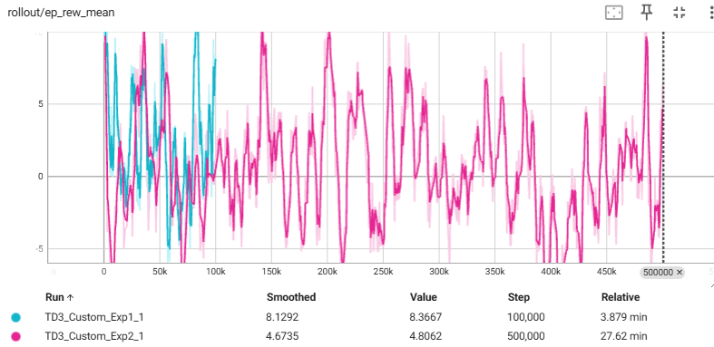
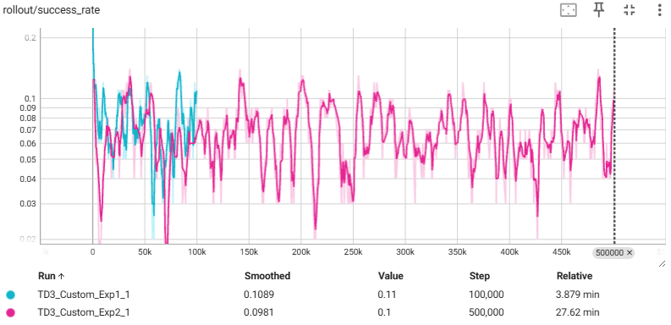
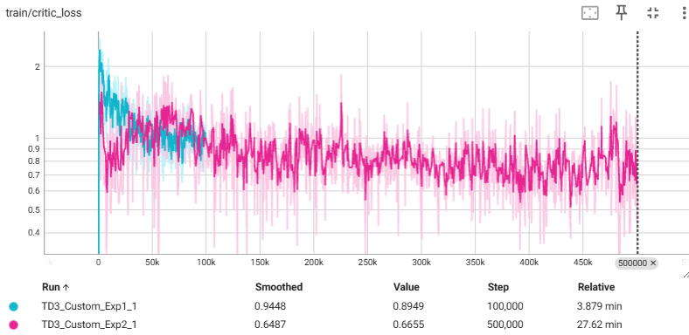
10
Inference & Visualization
Tensorboard Curves
next slide

Slide 11

Inference & Visualization
11
TD3_Manhattan_agent
ppo_Manhattan_agent
SAC_Manhattan_agent
next slide

Slide 12


Thank You!
Thank you for exploring the world of AI with us. For more information, please contact me at
Thanks to my supervisor:
Eng. Iten Elhak
sarashaban613@gmail.com
+201091047600

